Slide 1
Exploring Russian Realty Prices
Dylan Distasio
Foundations of data science
Capstone project

Slide 2
Introduction
This project is inspired by a Kaggle competition sponsored by Sberbank to come up with a prediction model for realty prices in the Russian market.
Sberbank has provided both property related information and historical macroeconomic data that may be useful in building a predictive model for future realty prices.
Exploratory Data Analysis and initial model building was performed using the R programming language
A linear regression model was selected as a first step in model building.

Slide 3
Data Structure
Training dataset of 30,471 observations with 292 potential features related to the Russian realty market including sales price data provided.
Macroeconomic dataset consisting of 2,484 historical records with 100 potential features provided.
Test dataset of 7,662 observations with 291 (sales price removed) of the same features of the training dataset was provided for model testing.
The training dataset was joined to the macroeconomic dataset using timestamps common to both.

Slide 4
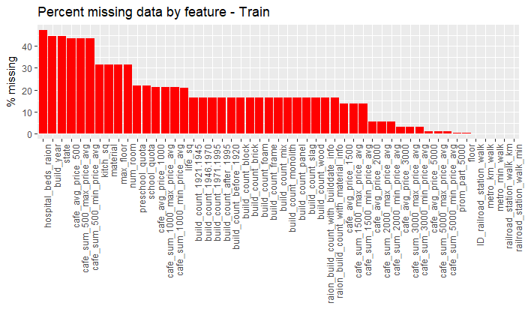
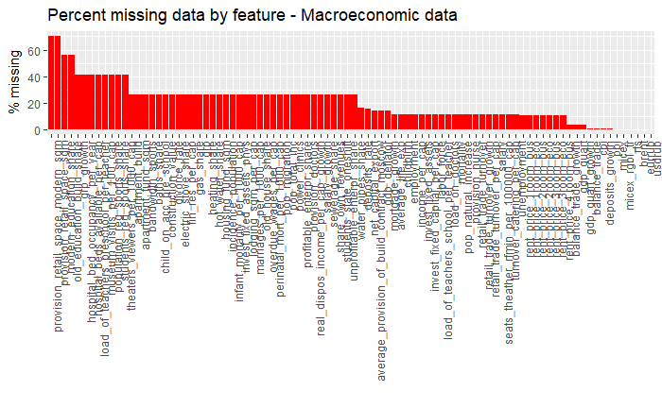
Exploratory Data Analysis
All fields in the training and macroeconomic data sets were examined for missing data.

Slide 5
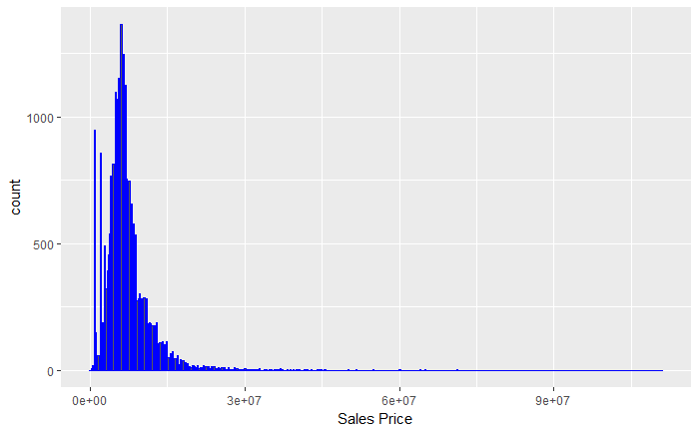
Exploratory Data Analysis
Distribution of sales prices is positively skewed with a long tail.

Slide 6
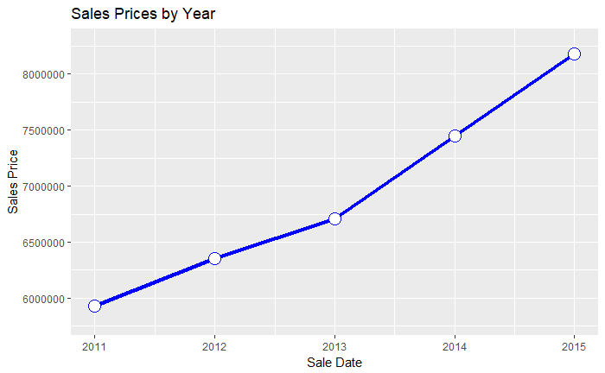
Exploratory Data Analysis
Sales prices were rising throughout the time period of the training dataset. This trend may impact model prediction accuracy.

Slide 7
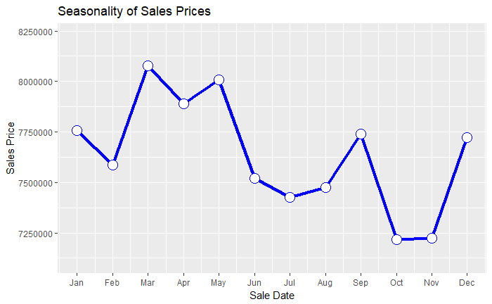
Exploratory Data Analysis
Seasonality based on month of sale was also examined.
There may be some seasonality present in realty prices, with highest prices early in the year, and weakness in mid Fall.

Slide 8
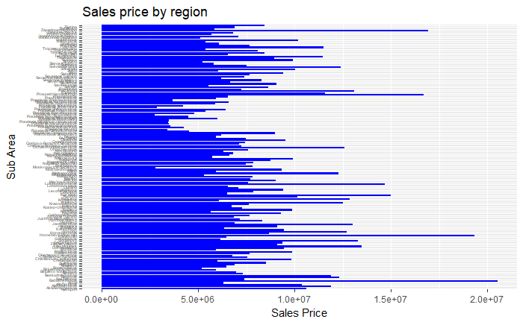
Exploratory Data Analysis
There is sales data from 146 different sub regions of Russia available.
Average sales price varies by region significantly.

Slide 9
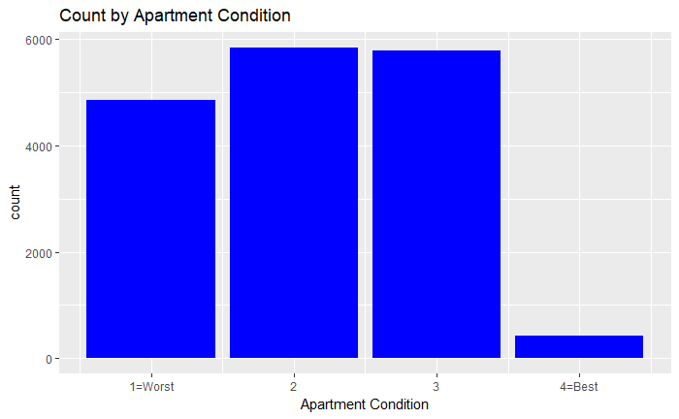
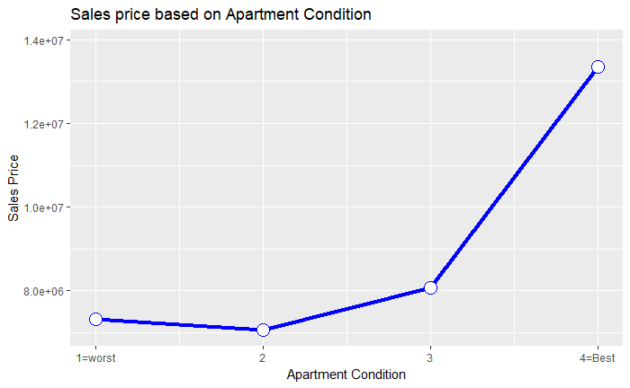
Exploratory Data Analysis
Data on the condition of each dwelling sold was provided which could be a feature of interest.
The majority of properties are in moderately good condition (2-3) in this dataset with a small number of properties in the best condition on a relative basis.

Slide 10
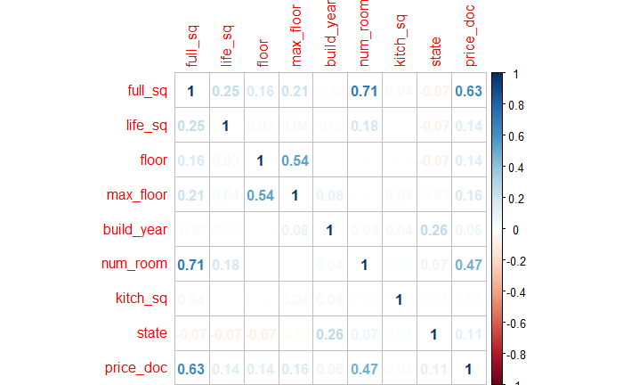
Exploratory Data Analysis
A number of potential features of interest related to the dwelling were examined for their correlation with the sales price.
The strongest correlations are between sales price and total sq footage and the total number of rooms in the dwelling.

Slide 11
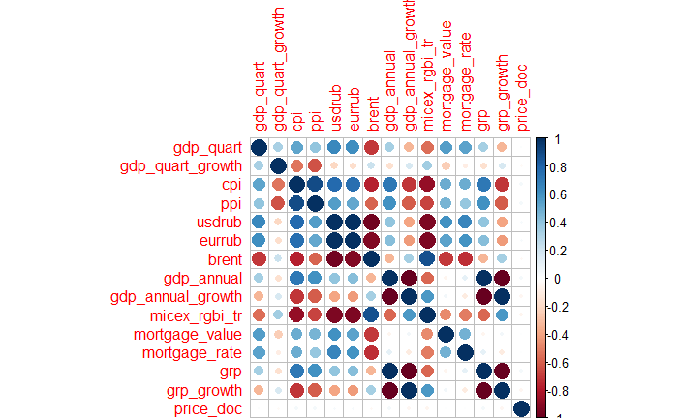
Exploratory Data Analysis
A number of macroeconomic features were also examined for correlation with sales price.
Somewhat surprisingly, there were no strong correlations between features and sales price. This may be due to lag in economic indicators affecting sales price.
There was a high degree of correlation amongst related macroeconomic indicators.

Slide 12
Model Building – Linear Regression - Dwelling
An initial linear regression model was constructed using features related to the dwelling itself with no regional or macroeconomic features added.
An adjusted R-Squared of 0.4303 was obtained from the model.
Residuals:
Min 1Q Median 3Q Max
-87894791 -1331623 193956 1407975 61674251
Coefficients:
Estimate Std. Error t value Pr(>|t|)
(Intercept) -3.601e+06 1.893e+05 -19.020 < 2e-16 ***
full_sq 1.474e+05 2.236e+03 65.919 < 2e-16 ***
life_sq -9.756e+02 5.038e+02 -1.937 0.0528 .
floor 4.356e+04 7.383e+03 5.900 3.72e-09 ***
max_floor 6.514e+03 6.277e+03 1.038 0.2994
build_year 4.421e+02 8.372e+01 5.280 1.31e-07 ***
num_room 1.048e+05 5.318e+04 1.971 0.0487 *
kitch_sq -7.187e+02 1.075e+03 -0.668 0.5040
state 9.372e+05 4.164e+04 22.508 < 2e-16 ***
---
Signif. codes: 0 ‘***’ 0.001 ‘**’ 0.01 ‘*’ 0.05 ‘.’ 0.1 ‘ ’ 1
Residual standard error: 3812000 on 14806 degrees of freedom
(2096 observations deleted due to missingness)
Multiple R-squared: 0.4306, Adjusted R-squared: 0.4303
F-statistic: 1400 on 8 and 14806 DF, p-value: < 2.2e-16

Slide 13
Model Building – Linear Regression – Dwelling + Macroeconomic Features
A second linear regression model was constructed incorporating a subset of macroeconomic features added to the existing dwelling based model.
This had little impact with a very slightly improved adjusted R-Square of 0.436.
Residuals:
Min 1Q Median 3Q Max
-89222498 -1322586 224859 1381799 51723569
Coefficients: (3 not defined because of singularities)
Estimate Std. Error t value Pr(>|t|)
(Intercept) 3.523e+05 6.052e+06 0.058 0.9536 full_sq 1.498e+05 2.391e+03 62.632 < 2e-16 ***
life_sq -8.048e+02 4.881e+02 -1.649 0.0992 . Floor 4.105e+04 7.774e+03 5.281 1.31e-07 ***
max_floor -9.880e+02 6.606e+03 -0.150 0.8811 build_year -1.338e+00 1.952e-01 -6.857 7.36e-12 ***
num_room -6.506e+03 5.600e+04 -0.116 0.9075 kitch_sq 2.713e+01 1.252e+03 0.022 0.9827
state 1.005e+06 4.318e+04 23.278 < 2e-16 *** gdp_quart -1.505e+01 1.120e+02 -0.134 0.8930
gdp_quart_growth -4.488e+04 2.901e+05 -0.155 0.8770 cpi -1.557e+03 1.716e+04 -0.091 0.9277
ppi -1.921e+03 8.419e+03 -0.228 0.8195 usdrub 6.667e+04 8.175e+04 0.815 0.4148
eurrub -4.993e+04 6.013e+04 -0.830 0.4063 brent -2.760e+03 1.364e+04 -0.202 0.8397
gdp_annual 6.582e+01 6.078e+01 1.083 0.2788 gdp_annual_growth NA NA NA NA
micex_rgbi_tr -1.830e+04 1.957e+04 -0.935 0.3497 mortgage_value -2.637e-03 1.550e-01 -0.017 0.9864
mortgage_rate -2.651e+05 2.783e+05 -0.953 0.3408 grp NA NA NA NA
grp_growth NA NA NA NA
---
Signif. codes: 0 ‘***’ 0.001 ‘**’ 0.01 ‘*’ 0.05 ‘.’ 0.1 ‘ ’ 1
Residual standard error: 3680000 on 12482 degrees of freedom
(17969 observations deleted due to missingness)
Multiple R-squared: 0.4368, Adjusted R-squared: 0.436
F-statistic: 509.6 on 19 and 12482 DF, p-value: < 2.2e-16

Slide 14
Model Building – Linear Regression - Final Iteration Dwelling + Macroeconomic + Regional Features
The final iteration of the linear regression model combined dwelling, macroeconomic, and sub region related information.
Adding in one region related feature significantly increased the adjusted R-square to 0.5595.

Slide 15
Findings
A relatively large number of potential features had a significant amount of missing data that may need to be addressed to improve model performance.
Based on a linear regression model utilizing a subset of dwelling, macroeconomic, and region related features, it was difficult to obtain a highly predictive model of the training data as measured by adjusted R-squared.
Due to a rank deficiency issue with the model, predictive capability on the test data set was unable to be tested.

Slide 16
Future Work
Continue to explore the data for additional cleaning, and address missing values.
Examine additional features for inclusion into a new model.
There are a large number of remaining features in the dataset that may prove useful in prediction.
There may also be the opportunity to do additional feature engineering to remove features that are highly correlated with each other.
Investigate potential lag between macroeconomic indicators and sales prices to engineer features that may be more predictive.
Examine additional model types that may prove a better solution than linear regression in predicting sales prices.
Logistical regression is one related possibility.

